Slide 1

Al Nafi
Let’s educate the world to make it a better place.
As Education Benefits All.
Education Benefits All.
© Al-Nafi. All Rights Reserved.

Slide 2
Trainer Profile : Abdeali Dodiya
I have 10+ experience in IT Industries , I have completed BCA and started my career as Linux administrator / Bash scripter , Python Automation.
I have hold so many certificate like CSCU, CCNA,CCNP, MCSA,MCP and Python.

Slide 3
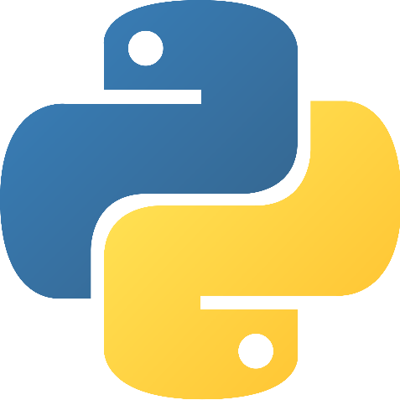
First Lecture
Python Automation
© Al-Nafi. All Rights Reserved.

Slide 4
What is Python ?
Python is an Object-oriented language programming languages.
Python is Independent languages.
© Al-Nafi. All Rights Reserved.

Slide 5

History Of Python ?
Python is an Object-oriented language programming languages created by Guido Rossum in 1989.
Many large companies use the python such as NASA, Google , YouTube , BitTorrent, Facebook, Instagram, etc .
© Al-Nafi. All Rights Reserved.

Slide 6
Python Automation Course Outline
Introduction to Python Basic python commands Variables in python String operation in python Data Structure of python Operators of python Conditional statements Modules in python working with different files in python Exception handling in python Regular expression Remote modules in python Real time Hands-On practical
© Al-Nafi. All Rights Reserved.

Slide 7
Python Script Commands
$ Python
>>> print ‘Hello, Alnafi’
>>> exit()
$ which python
$ Execute Python script
$ ./pythonfilename
OR
$/home/abdeali/pythonfilename
OR
$python pythonfilename
© Al-Nafi. All Rights Reserved.

Slide 8
جزاك اللهُ
To ask questions, please contact
stream@annaafi.org
© Al-Nafi. All Rights Reserved.

